Slide 1
VIRTUAL AI-ASSISTANT
-PAA BHAI
​

Slide 2
CONTENTS
INTRODUCTION.
OBJECTIVES.
LITERATURE WORK.
EXISTING WORK.
PROPOSED WORK.
SYSTEM FUNCTIONS.
SPACE EXPLORATION.
AI-AUTOMATIONS.
SYSTEM FLOW DIAGRAM.
HARDWARE/SOFTWARE.
EXPERIMENTAL RESULTS.
CONCLUSION, FUTURE WORK.

Slide 3
ABSTRACT
An assistant is a software agent to interpret human speech and perform tasks without interaction.
Handsfree service that is Self-voice is turning into input device than conventional enter-keys.
They can do tasks that an executive assistant would typically handle such as making notes, making phone calls, texting messages and organizing emails.
Implementation will offer help with assistance at the workplace.

Slide 4
OBJECTIVES
Inclusion of most day-to-day tasks using voice commands.
Automation of windows-based desktops for website, applications.
Reducing user's screen time and enhancing the ability to multitask.
Emotional Speech Recognition:- AI detecting and neglecting curse words.

Slide 5
INTRODUCTION
A intelligent personal assistant is a software agent that can perform tasks without interaction.
Services for an individual based on verbal commands.
Handsfree service.
They can do tasks that an executive assistant would typically handle such as making notes, making phone calls, texting messages and organizing emails.

Slide 6
Existing Work to Undertake
Problem for users with internet instability, server problems and places where internet is not accessible.
Misinterpreting or misidentifying a particular query.
Data privacy and Security.
Challenge of language ,accent, dialect.

Slide 7
Proposed work
The program which receive audio input through mic.
The speech recognition software will detect the input and redirect it to the backend.
The program will perform the command based on the interest of the user.
The output will be presented to the user.

Slide 8
System Functions
Open/Closure of websites, web pages
Sending E-Mails
Temperature of anywhere
Text-reader/Audio book
Time-Table
Screenshots
Internet Speed
Wikipedia Search
Music Play
Alarm and Clock
YouTube Search
Google Search
Cracking Jokes
Query Repetition
Location
Remember, save and tell information
Translator
Place Locator
Hide Files
Battery
Volume
News Headlines
Calculator
Cricket Scores
Camera-click pictures
Clap Detection
Password Protection

Slide 9
Space Exploration
Date wise Space news from Nasa
Image Captures from Martian Rovers
International Space Station Tracker
Tracking Space Objects
Dataset on Solar Bodies
Corona Virus Tracker

Slide 10
Assistance - Automations
Lights Automation:- Smart Lights
Refrigerator Automation:- Smart refrigerators
WhatsApp Automation:- Automatic Verbal Messaging and Calling
Notepad Automation:- Automates Notepad based on voice Command​
MS Teams Automation:- Automates MS Team and Manages classes​
YouTube Automation:- Plays you tube video on voice Commands
Chrome and Windows Automation

Slide 11
System Flow Diagram
Audio Command and Verbal Query.
Microphone
Api calls
Speech Recognition
Backend Processing
Task Execution

Slide 12
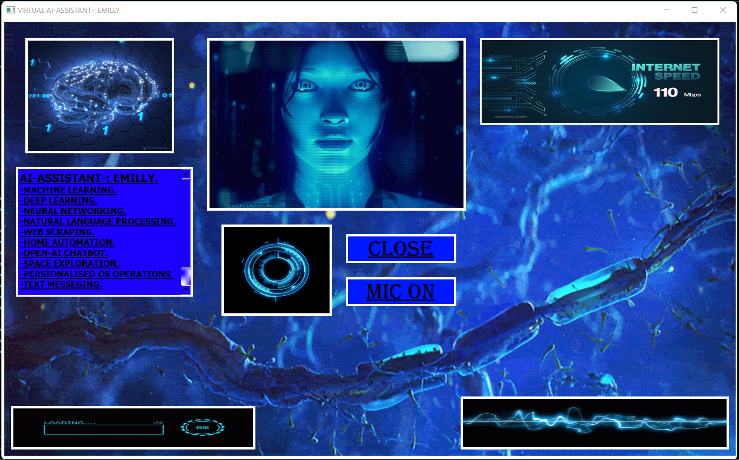
Experimental Results

Slide 13
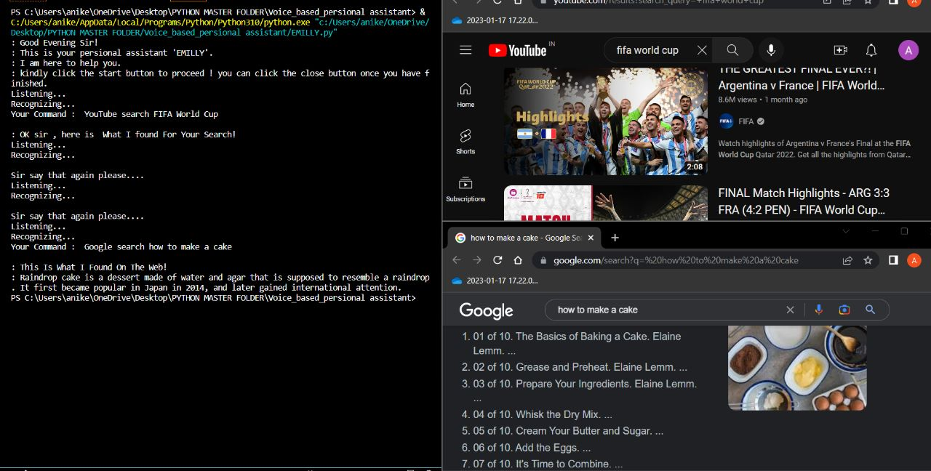
Experimental Results

Slide 14
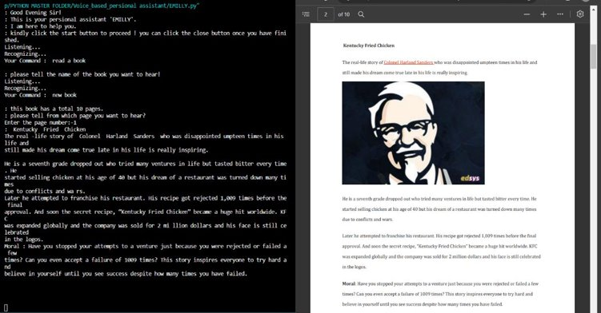
Experimental Results

Slide 15
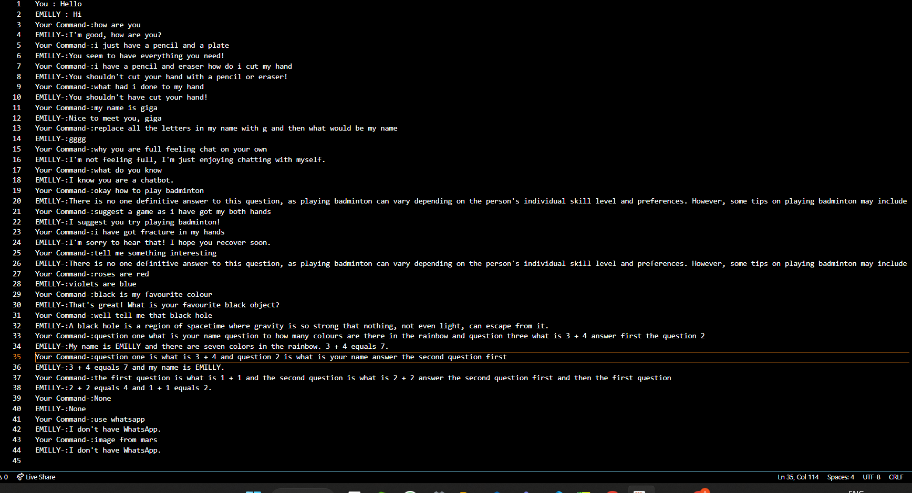
Experimental Results

Slide 16
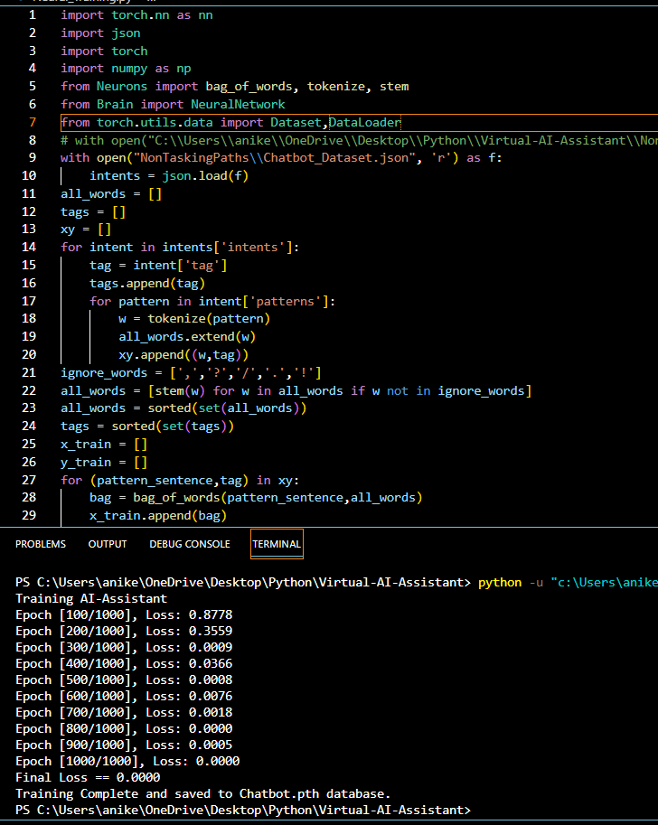
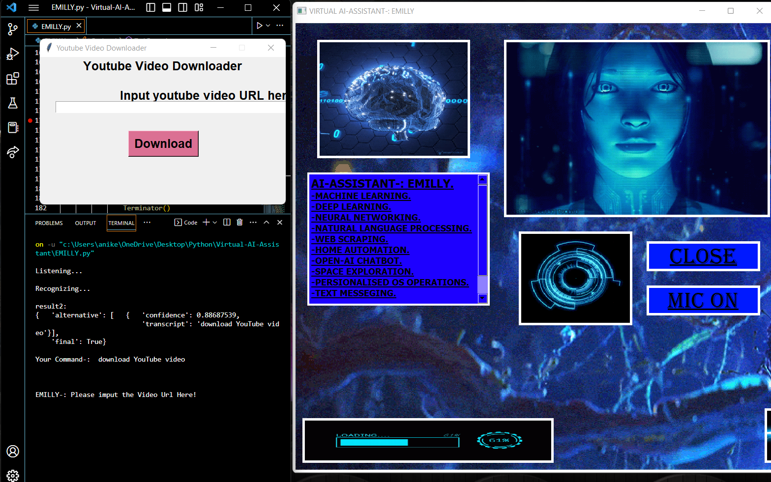
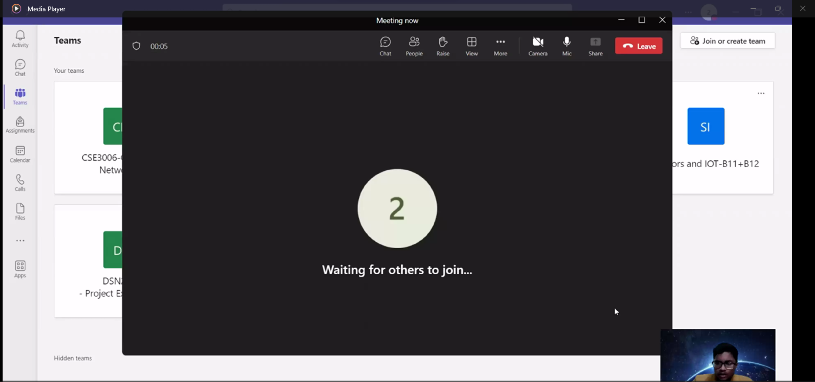
Experimental Results

Slide 17
Hardware, Software Requirements
HARDWARE-:
Pentium-Pro Processor++
RAM 512MB++
PC or a Laptop
A Microphone
SOFTWARE -:
Python, Selenium
Virtual Studio Code
Audacity, Qt-Designer
BlueStacks, Handbrake
OpenShot

Slide 18
Future Work and Conclusion
Future Possibilities:-
To achieve a smooth Web Automation
More Optimized Backend
Adding More Functions as per need
Adding More AI Automations
Conclusion:-
The project concludes here, new updates can be added as per need and optimization of the program.

